Slide 1

Introduction to Components

Slide 2
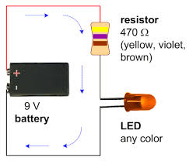
What is a Circuit?
Electricity running in a loop with a starting point and ending point – and a number of components in between.
Can include resistors, diodes, inductors, sensors of all shapes and sizes, motors, and hundreds of thousands of other components.
OHM’S LAW
Voltage = Current x Resistance
V = IR
Voltage is measured in VOLTS (V)
Current is measured in AMPERES (A)
Resistance is measured in OHMS (Ω)
The LED above needs 20 mA (milliamps) of current. What size resistor should you use?
Notes:
Answer: 450 ohms

Slide 3
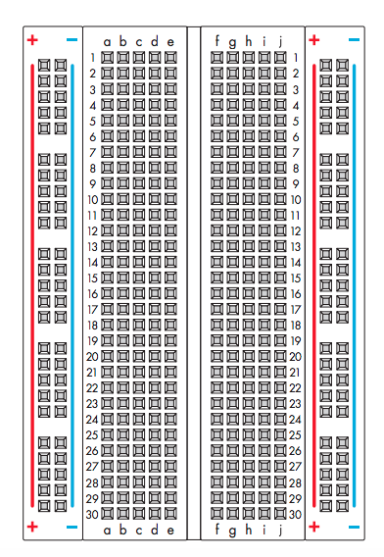
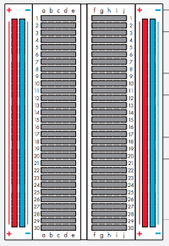
Breadboard
How it looks
How it’s connected
Connect power to the + vertical columns
Connect ground down the - vertical columns
Components placed along horizontal rows will be connected when power is running.
This line divides the board in half

Slide 4
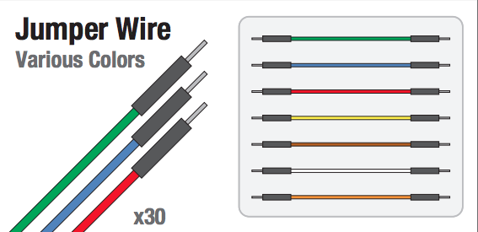
Jumper Wire

Slide 5
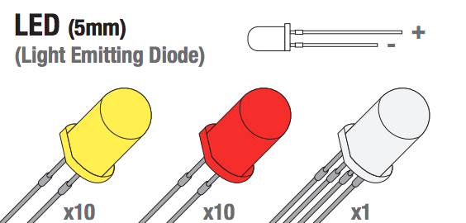
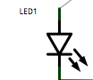
Light Emitting Diode (LED)

Slide 6
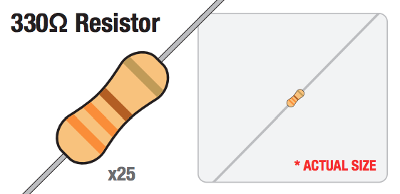
330 Ω Resistor

Slide 7
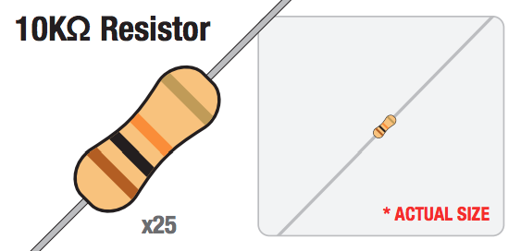
10 kΩ Resistor

Slide 8
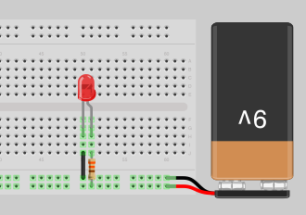
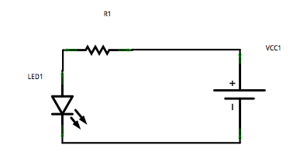
Notes:
Explain Anode, and Cathode.

Slide 9
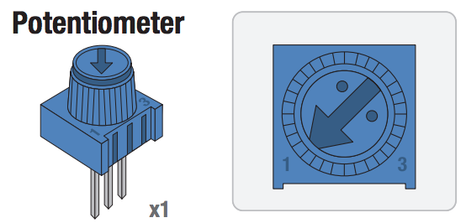
Potentiometer

Slide 10
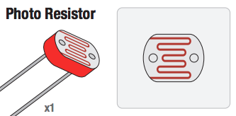
Photo Resistor

Slide 11
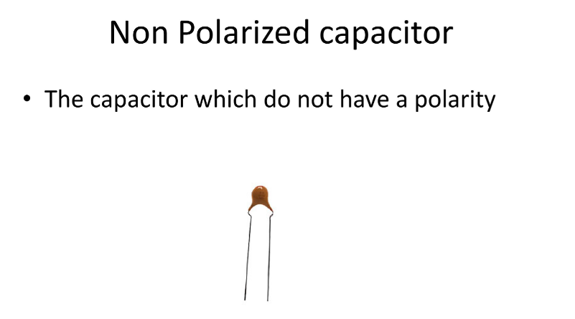
Capacitor

Slide 12
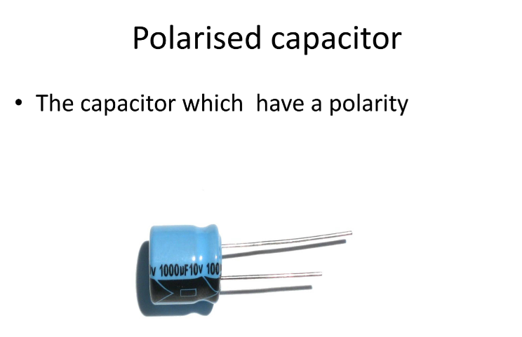
Capacitor

Slide 13
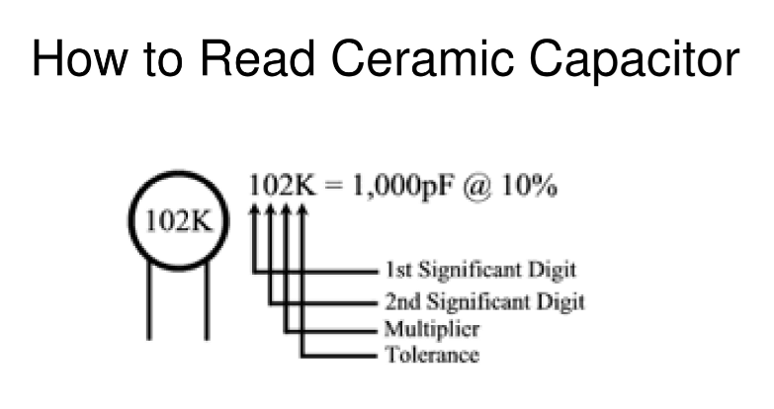
Capacitor

Slide 14
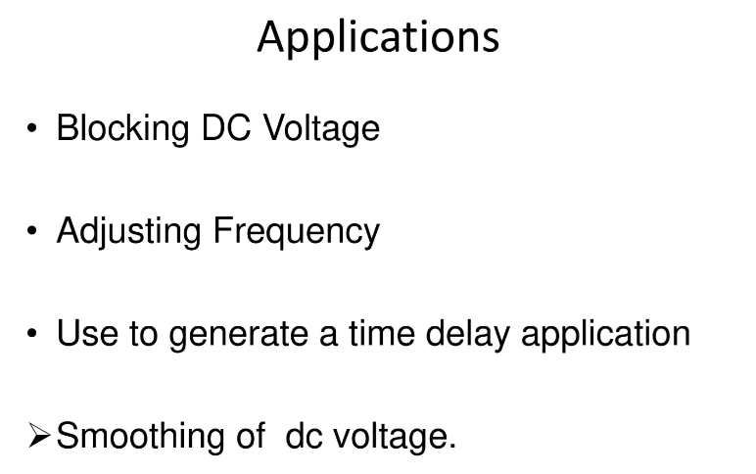
Capacitor

Slide 15
Arduino
Arduino is the go-to gear for artists, hobbyists, students, and anyone with a gadgetry dream.
Arduino rose out of another formidable challenge: how to teach students to create electronics, fast.
With Arduino, you can control almost everything around you be it simple LED or giant Robots.

Slide 16
Arduino
Basically Arduino is Microcontroller.
Microcontroller is microprocessor with memory, RAM and some other peripheral connected with it.
The Arduino Uno is a microcontroller board based on the ATmega328 . The ATmega328 has Flash memory of 32 KB (with 0.5 KB used for the bootloader). It also has 2 KB of SRAM and 1 KB of EEPROM
Notes:
Flash- Where program is stored.
SRAM-Static Random Access Memory ( sketch creates and manipulates variables when it runs )
EEPROM- Electrically Erasable Programmable Read-Only Memory ( memory whose values are kept when the board is turned off )

Slide 17
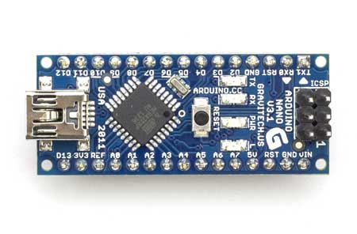
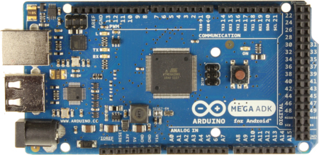
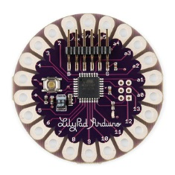

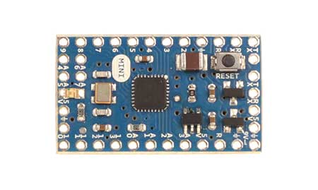
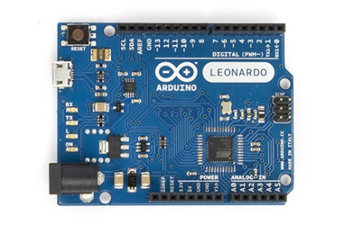
Types of Arduino Boards
Arduino Nano
Arduino Mega
Arduino LilyPad
Arduino Uno
Arduino Mini
Arduino Leonardo

Slide 18
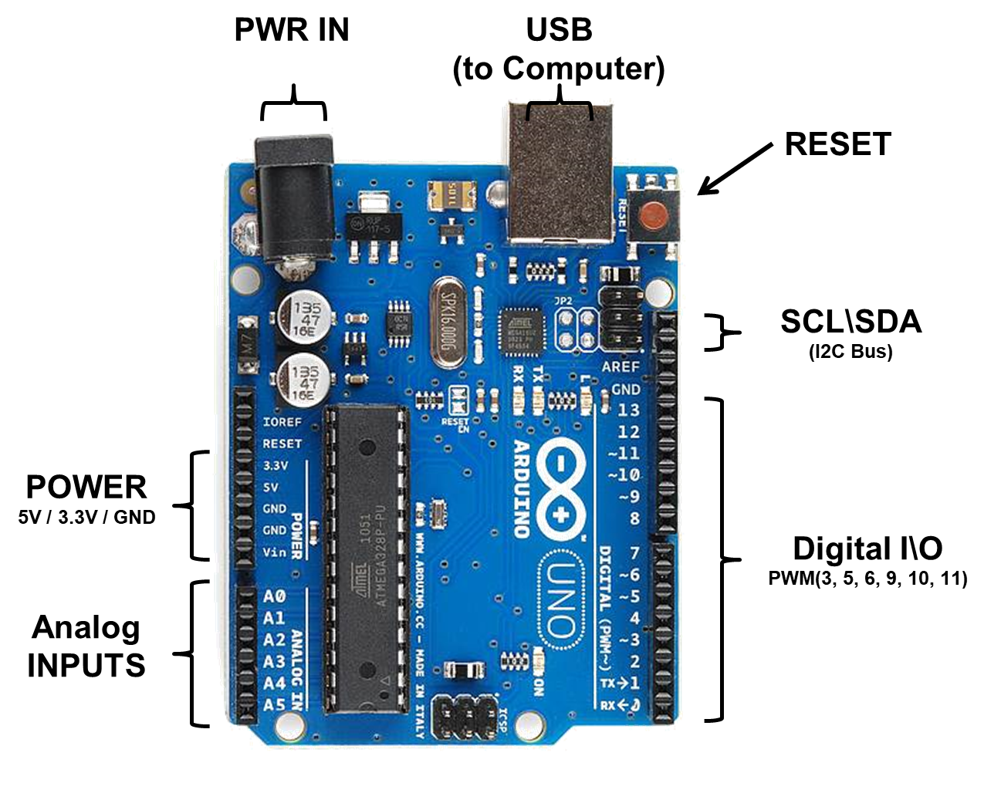

Slide 19
Arduino Uno
Power In (Barrel Jack): Can be used with either a 9V or 12V wall-wart or battery
Power In (USB Port): Provides power and communicates with your board when plugged into your computer via USB.
LED (RX: Receiving): Lights up when the Arduino is receiving data (such as when being programmed).
LED (TX: Transmitting): Lights up when your Arduino is transmitting data (such as when running a program).
LED (Pin 13: Troubleshooting): LED is incorporated into your sketch to show if your program is running properly.
Pins (ARef, Ground, Digital, Rx, Tx): Used for inputs, outputs, power, and ground.
LED (Indicates Arduino is ON): Simple power indicator LED.
Reset button: Used to manually reset Arduino, which makes code restart.
ICSP Pins: For “in-circuit serial programming,” used if you want to bypass the bootloader.
Pins (Analog In, Power In, Ground, Power Out, Reset): Used for inputs, outputs, power, and ground.

Slide 20
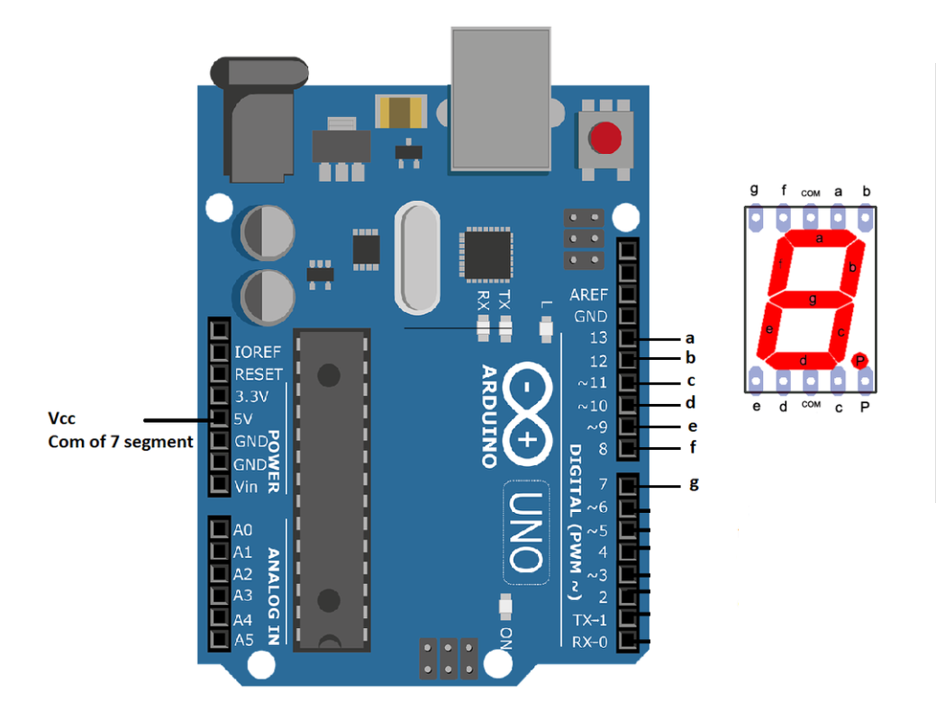
Notes:
Look up analog ref

Slide 21
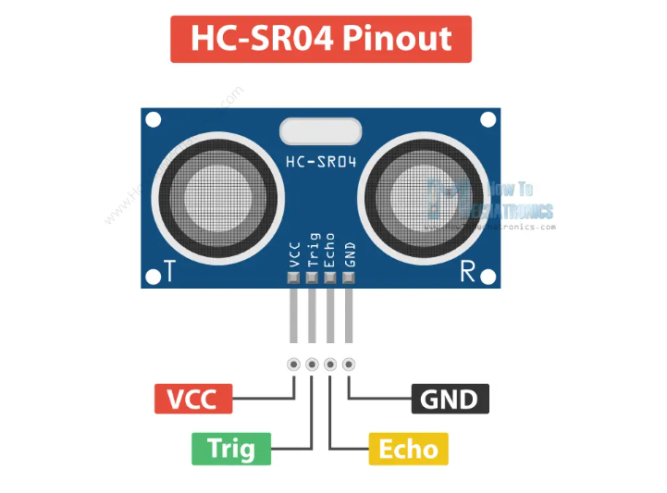
.

Slide 22
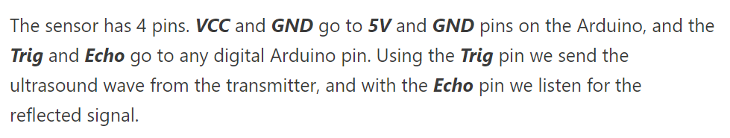
.

Slide 23
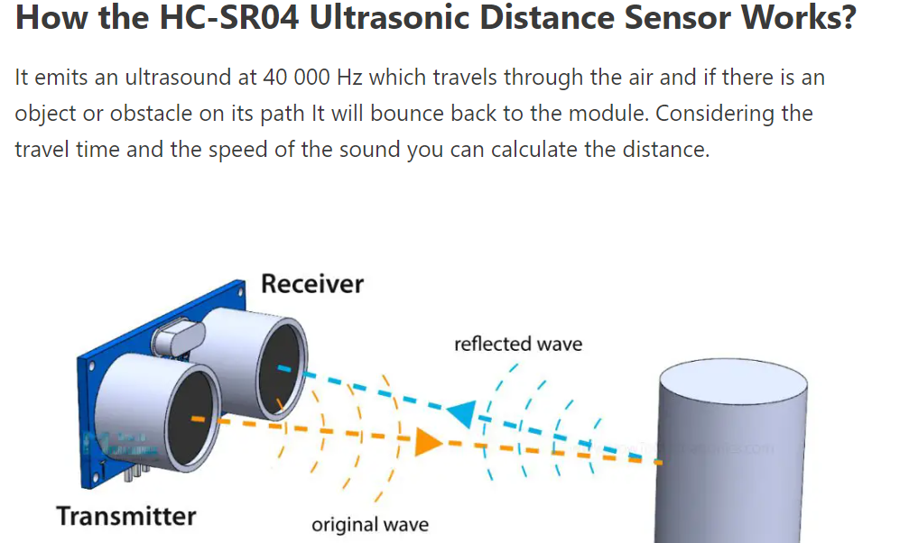
.

Slide 24
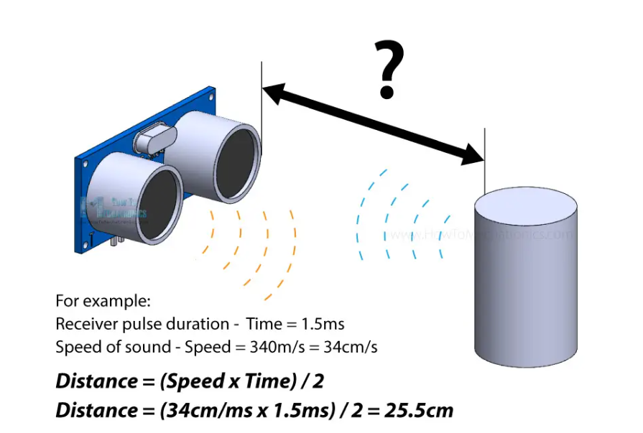
.

Slide 25
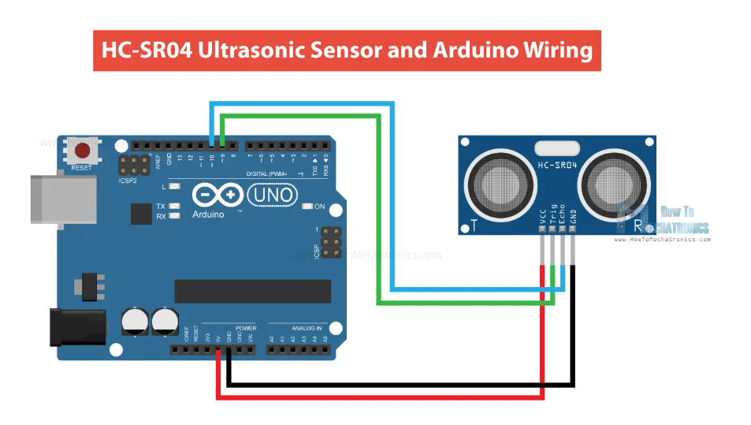
.

Slide 26
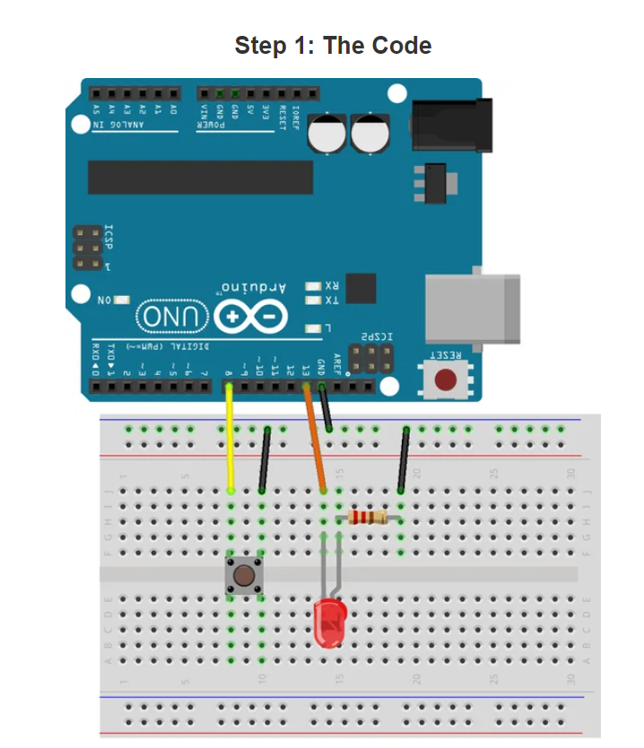

Slide 27
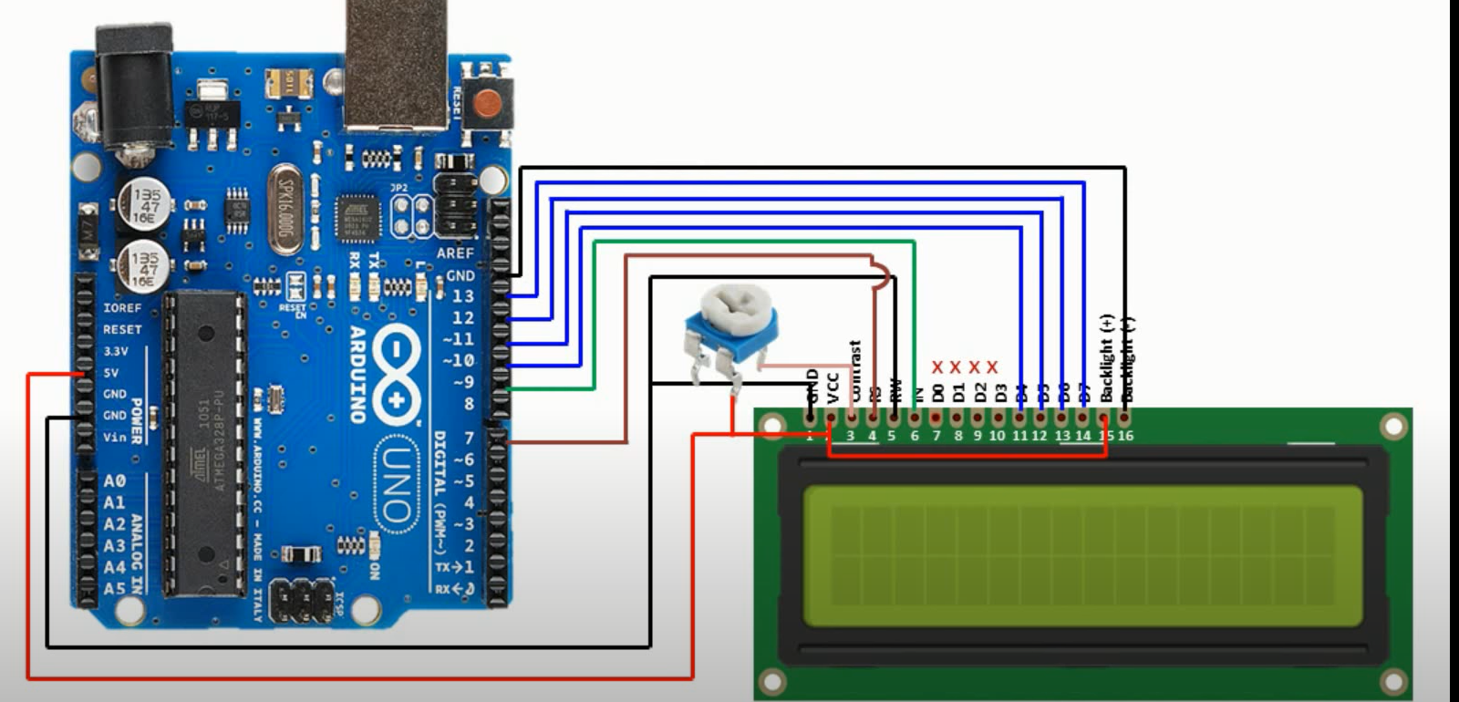
.
Comparative Analysis :-
Notes:
`

Slide 28
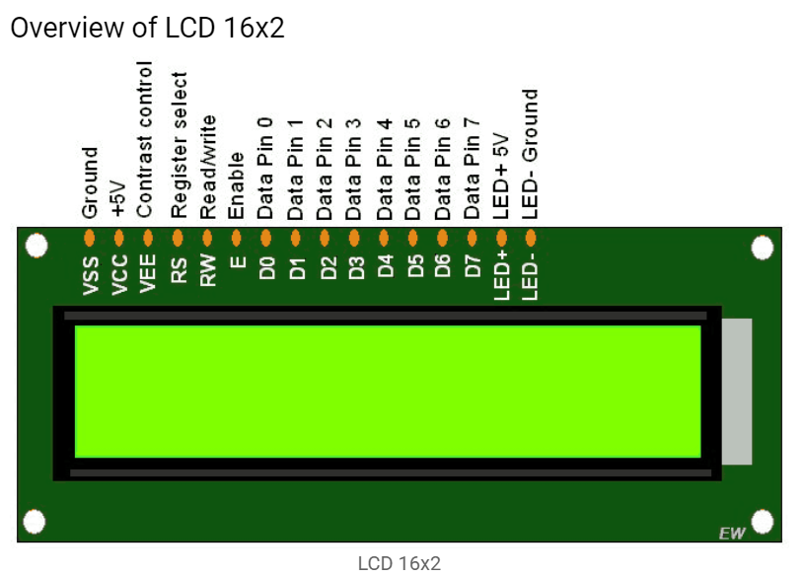
.

Slide 29
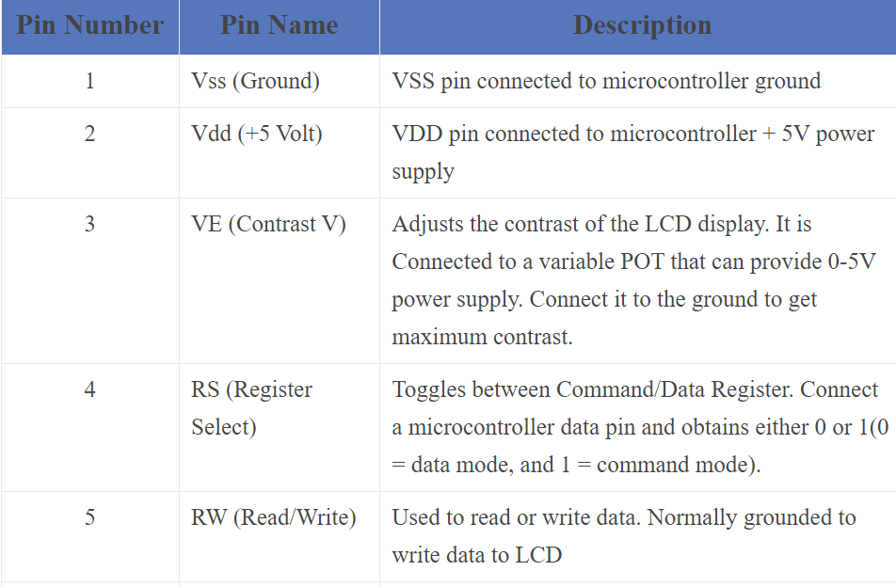
.
Comparative Analysis :-

Slide 30
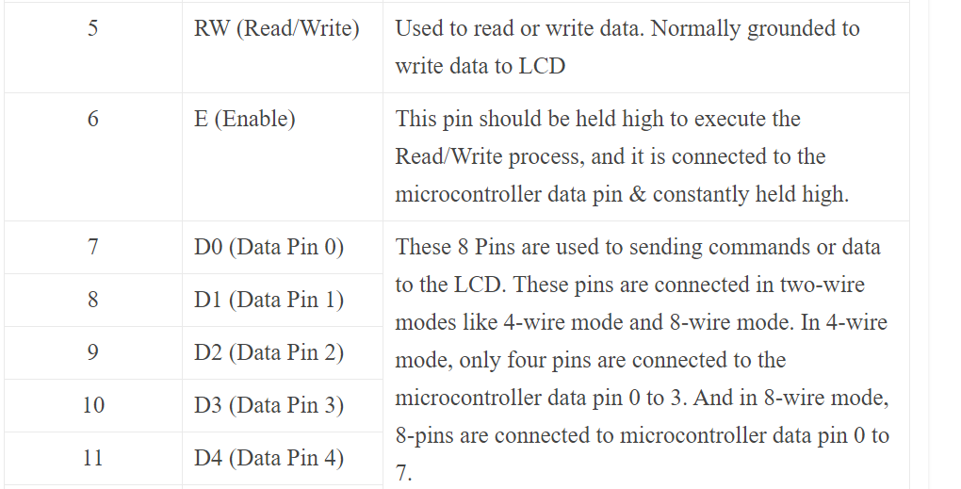
.
Comparative Analysis :-

Slide 31
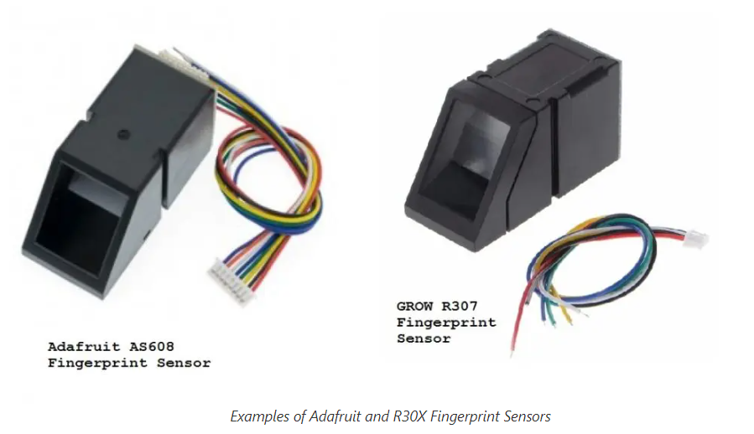

Slide 32
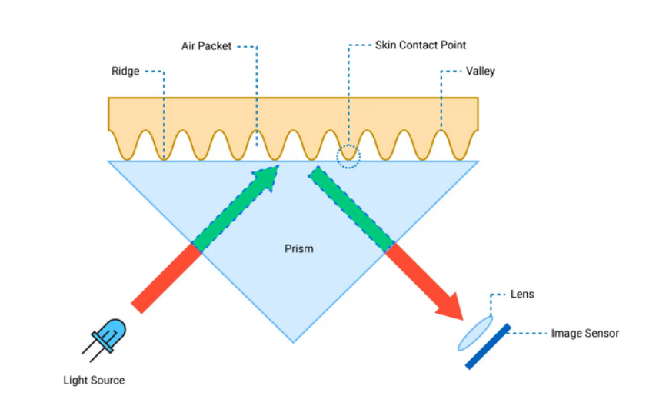

Slide 33
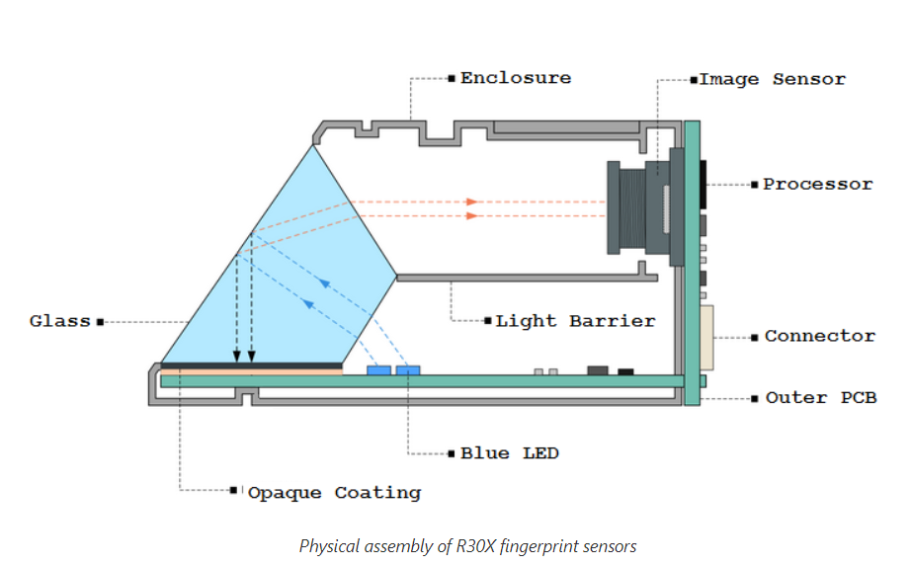

Slide 34
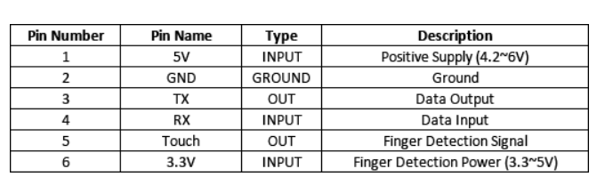

Slide 36
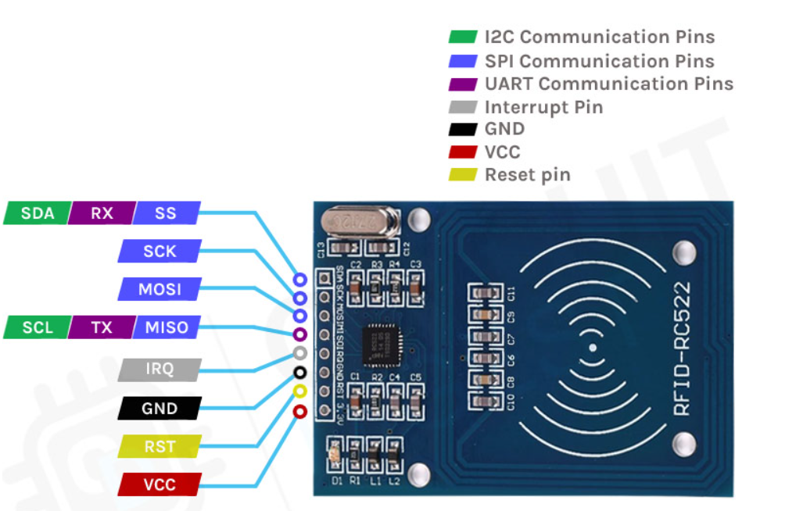

Slide 37
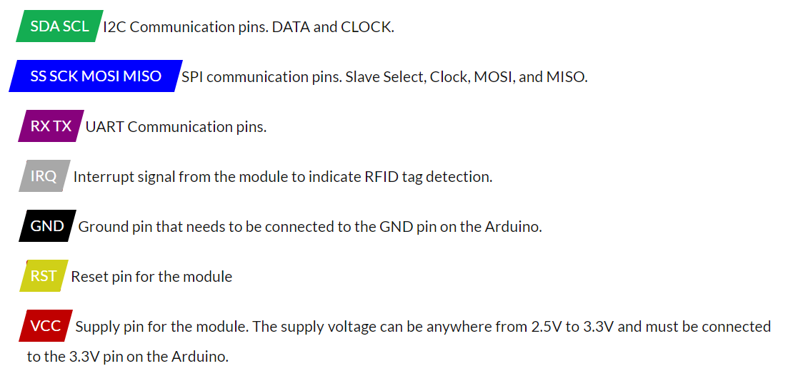

Slide 38
